Slide 1
Discount Sharing and Searching System
Xinyun Chen chen.xinyu@husky.neu.edu
Xingyao Wu wu.x@husky.neu.edu
Github : https://github.com/gurge3/scala_final_project

Slide 2
Introduction
Online shopping and E-commerce are people’s top choice to spend their money.
Learning the discounts on various businesses and products are one of the most favorite things for every consumer.
With the most updated deal information and analytics provided, consumers can be guided to find out the cost-effective products and the best place to buy what they want.

Slide 3

Propose
Design a scala-based system
Search discounted prices and channel of specific product or brand within a certain period of time
Show the trend of discount activities for any brand or E-commerce platform
Recommend the most frequently and most popular discounted in certain category
Notes:
Crawl and analyze the data of Dealmoon website Implement data visualization techniques and prediction algorithm

Slide 4
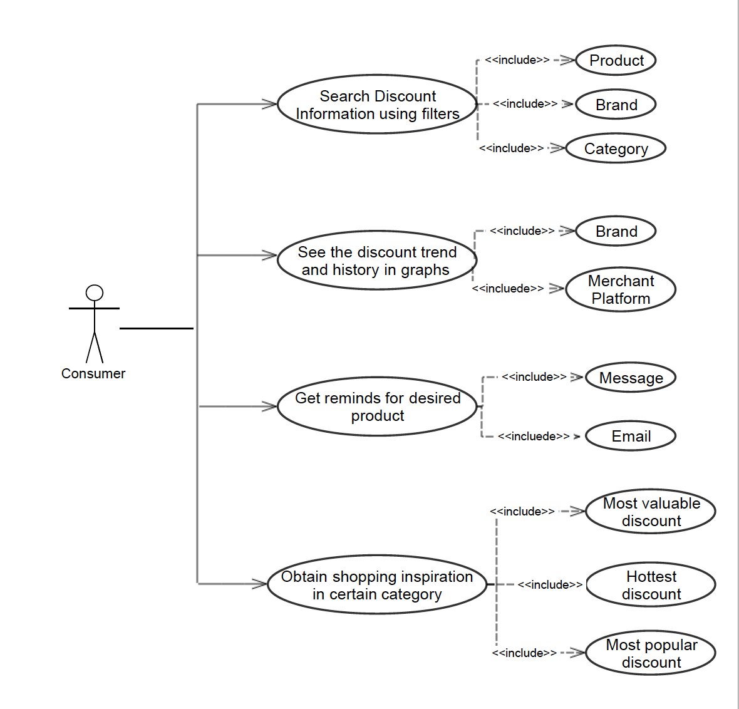
User Story

Slide 5
Methodology
Data Crawler
Data Analyze
Data Visualization
Build a real-time crawler to collect useful fields including product, brand, discount information, price, favorites, timestamp and organize into structured data
Process the data to sort the discount of specific brands or products in a certain period.
Retrieve and analyze the key factors which influence the consumer’s feedback of discount information
Realize a graphical user interface for users to look up for the best deal.
Diagrams and charts will also be implemented to represent the historical trends of the discount.

Slide 6
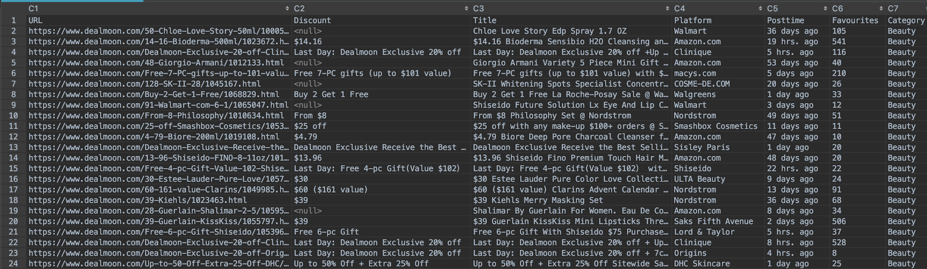
Data Sources
Remote data crawled from Dealmoon.com

Slide 7




Technologies & Tools
Web Crawler
Data Analysis
User Interface

Slide 8
Formulate project plan and tasks, research web crawler, Spark and Play framework
Work with Spark framework, design algorithms for data analysis
Design test cases, test, improve and demo
Sprint 1
Sprint 2
Sprint 3
Sprint 4
Sprint 5
11.05 - 11.11
11.12 - 11.18
11.19 - 11.25
11.26 - 12.02
12.03 - 12.07
Implement web crawler with JSoup & Akka, collect and organize into structured data
Design user interface with Play framework, connect front-end with back-end

Slide 9
Acceptance Criteria
90% of the elements will be executed and finished within 10 seconds
The return result based on user request and application’s filters will present 5 best results(if exists)

Slide 10
Thanks for watching

